Slide 1



CENTERS OF FRIENDSHIP, INTER-ETHNIC HARMONY AND TOLERANCE IN THE BORDER REGIONS OF KYRGYZSTAN, UZBEKISTAN AND TAJIKISTAN.

Slide 2
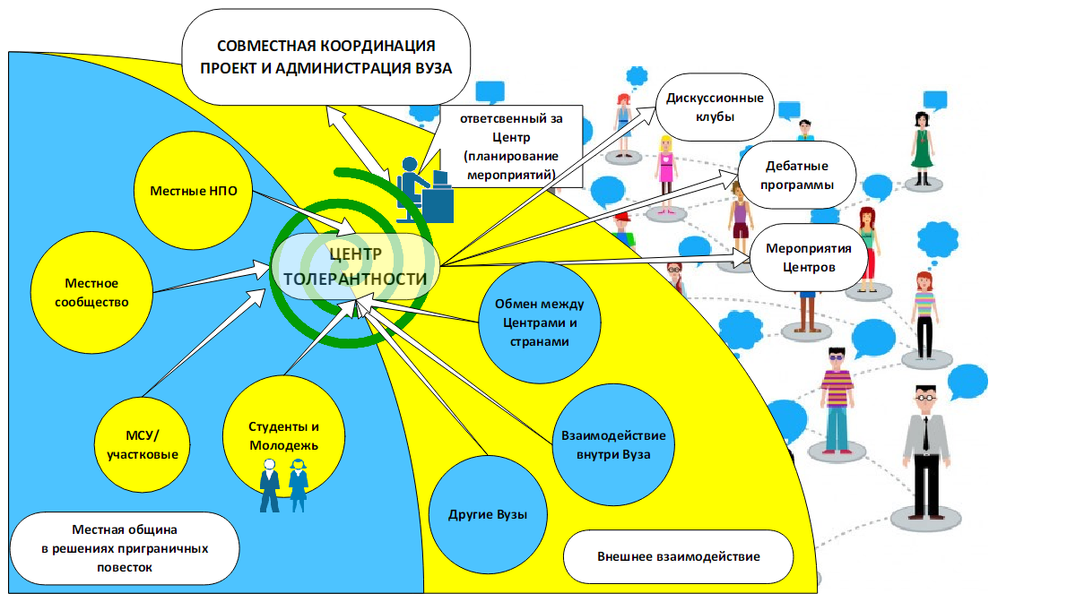
The centers function as a " Hub " - a dynamic networking hub for various cross-border initiatives, capacity building activities for civil society organizations and youth discussion platforms, as well as for the development of educational and information materials.
collaborative coordination between the project and the HEI
discussion club
local community
responsible for the Center
debate
programs
local authorities
Centers
center activities
exchanges between centers and countries
local NGOs
Students and young people
Interaction within the university
other universities
local communities in addressing cross-border agendas
external communication

Slide 3
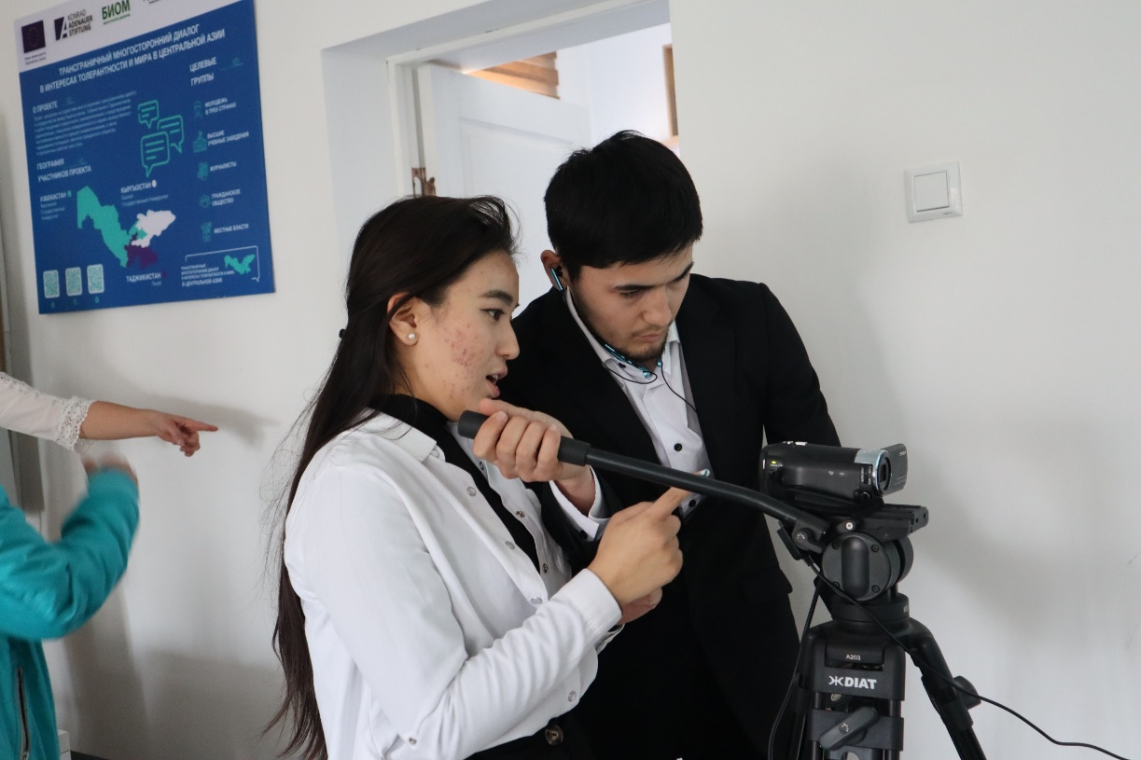
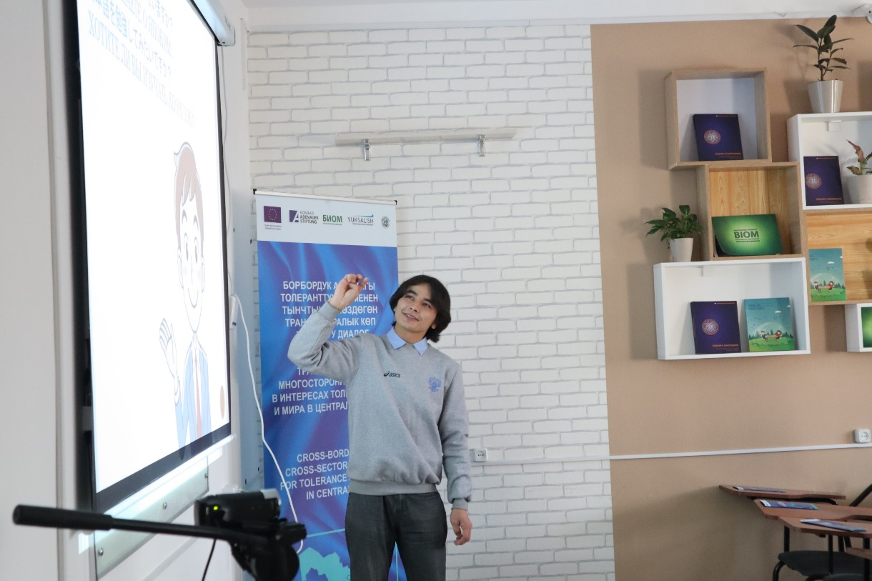
EQUIPMENT OF THE CENTERS
The center is provided with modern equipment to ensure the involvement of all participants of online and offline events in a single discussion space. The center functions as a three-dimensional model: educational discussion and debatecenter / a virtual conference / video production studio.

Slide 4
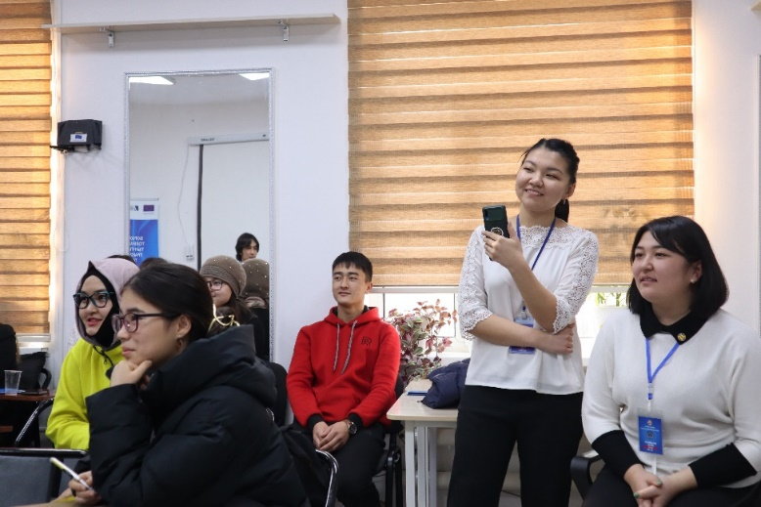
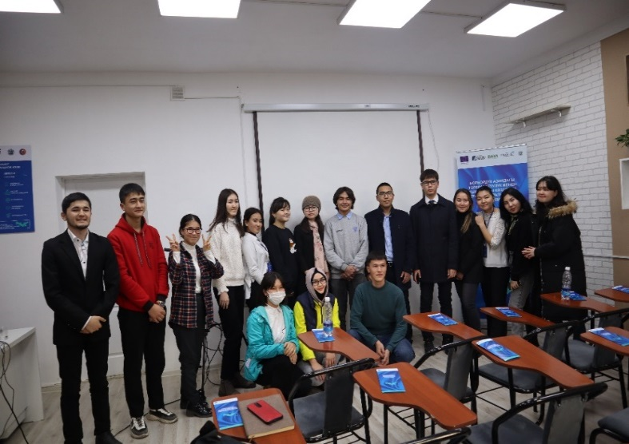
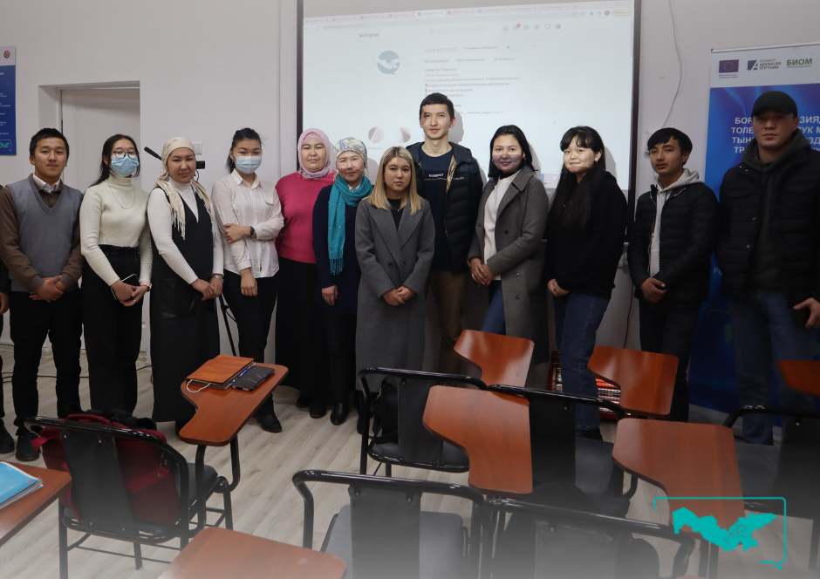
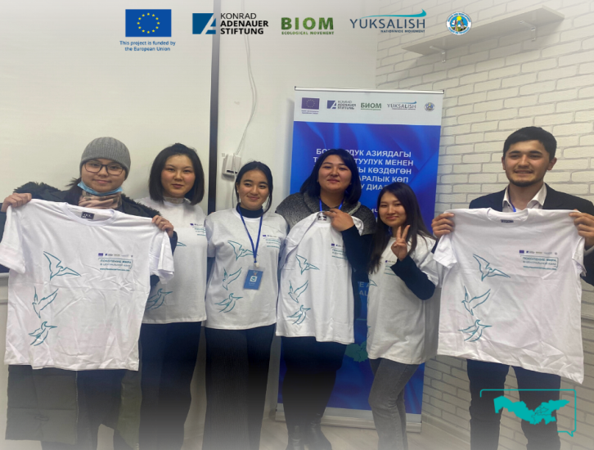
«GENERATION OF PEACE IN CENTRAL ASIA»
To support the project's activities, events at the Center and their coverage in the social networks of the three countries, an initiative youth group "Generation of Peace in Central Asia" was formed in each Center. The group consists of active university students and local youth. university students and local youth. Young people promote ideas of peacebuilding, tolerance and inter-ethnic friendship in social networks, support coverage of the Centers' activities and independently organize various events for young people throughout the project activities. The total number of people involved in project activities is more than 200 in each country. By the end of the project at least 2,500 people from the project target group will have been reached.

Slide 5
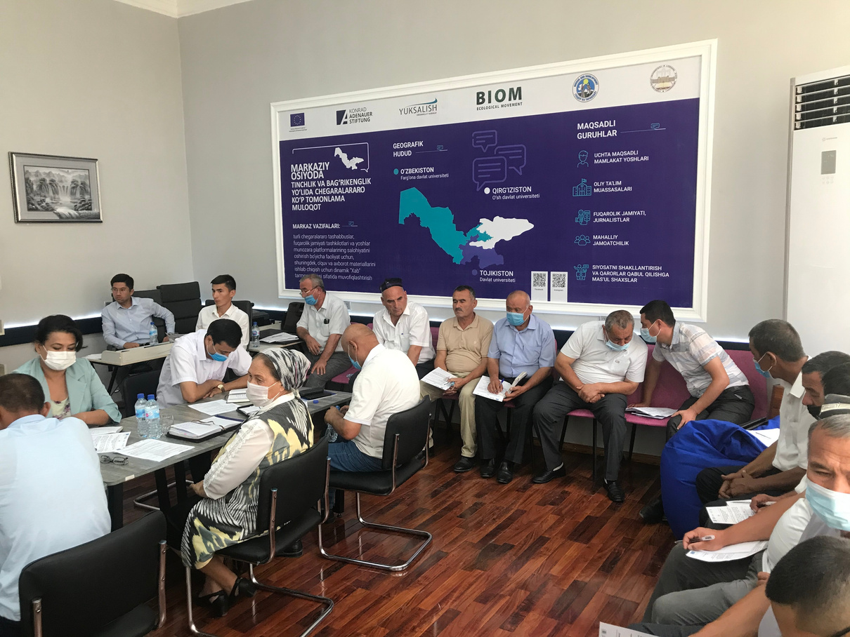
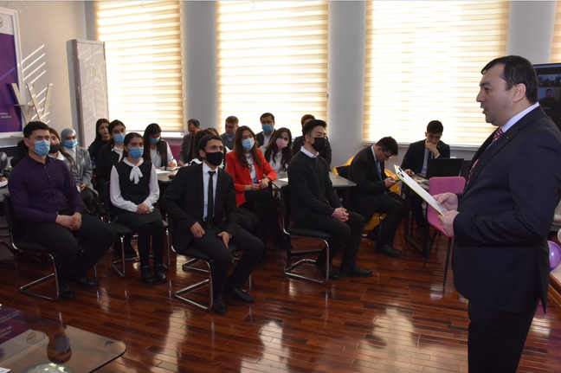
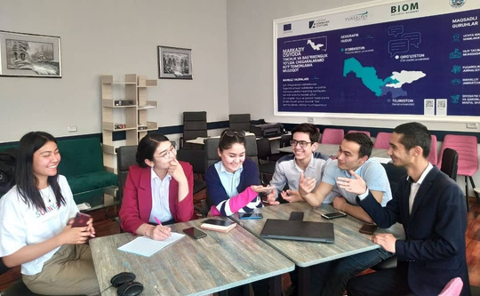
TOLERANCE CENTER
IN FERGANA STATE UNIVERSITY
Roundtable for representatives of the local community
Master class for young people, students and teachers of FerSU
Series of trainings for young people
During the year of the existence of the center, it has held a number of trainings for young people, students and teaching staff of Fergana State University on the use of online tools, round tables for representatives of local authorities and the public to promote peacebuilding among the youth of Fergana, various online conferences and master classes for all interested persons.

Slide 6
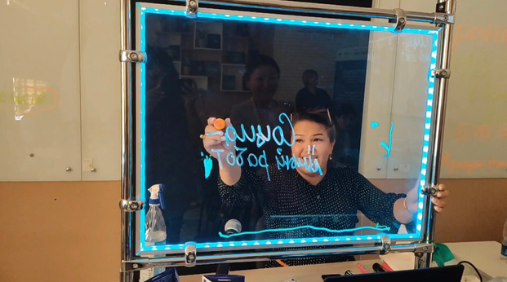
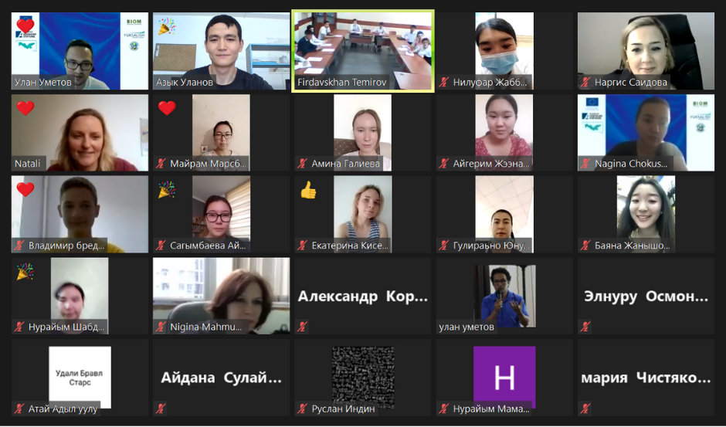
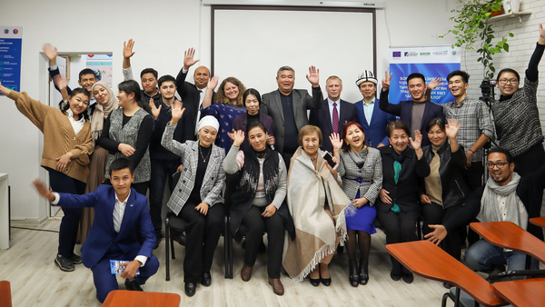
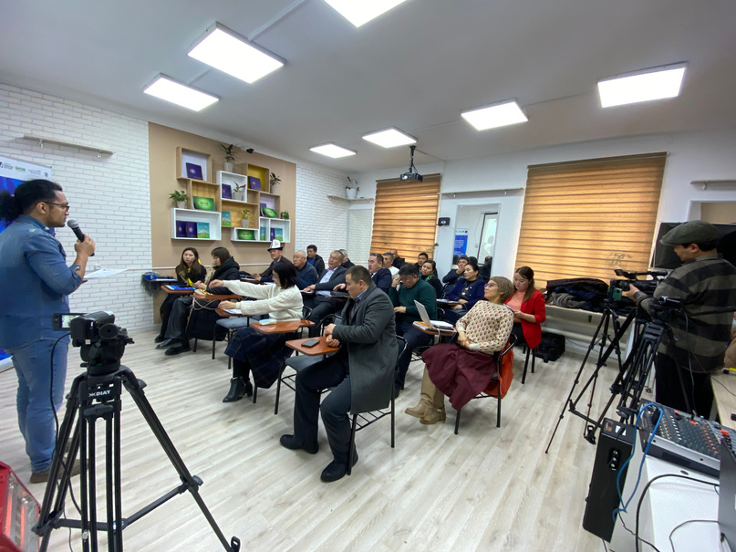
TOLERANCE CENTER
IN OSH STATE UNIVERSITY
Today, the center regularly organizes various events, trainings and roundtables for students, teachers and all interested groups.
Online events in the Tolerance Center
Training on the use of online tools in the educational process
Roundtable discussion

Slide 7
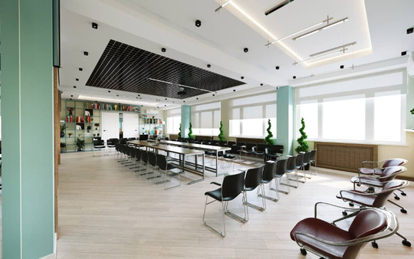
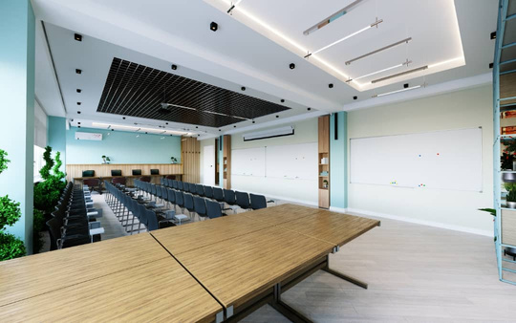
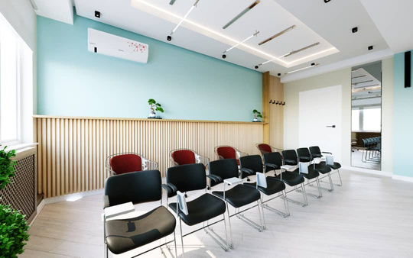
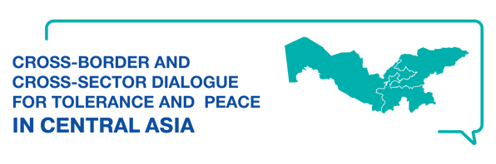
CONCEPT DESIGN OF THE CENTER FOR FRIENDSHIP AND INTERETHNIC HARMONY AT THE KHUJAND POLYTECHNIC LYCEUM, CHOSEN BY THE STUDENTS.
At present, as part of the project, we are preparing to open a Center for Friendship and Inter-ethnic Harmony at the Khujand Lyceum. Preparatory work and the purchase of equipment is being actively carried out at the Center, and an open vote among students enabled us to choose the final design of the future Center.

